Slide 1
PR283
Sokoban
ISAAC MACKLE

Slide 2
WinForms View
Manual lay-out of components

Slide 3
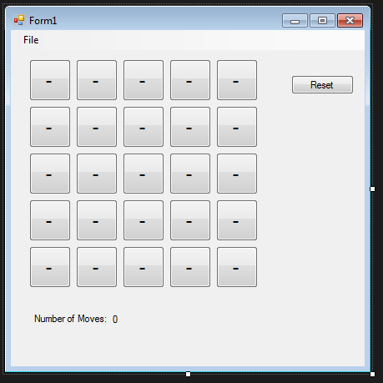
Manual lay-out of components
The button grid has been manually laid out through drag and drop from the toolbox. All the buttons have been manually labelled to what position they are.
WinForms View: Manual lay-out of components

Slide 4
Must List Features
Display the Pieces as distinct images
Display the Move Count
Actually works – is playable - updates!
WinForms View: Manual lay-out of components

Slide 5
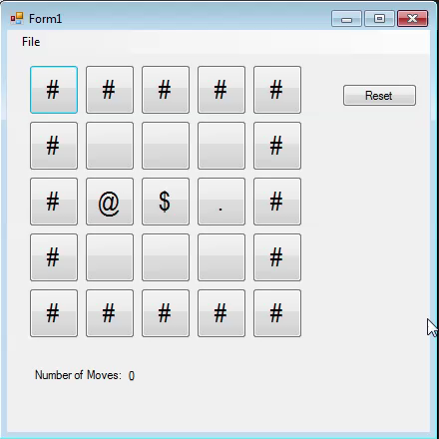
The Working Features - VIDEO
WinForms View: Manual lay-out of components

Slide 6
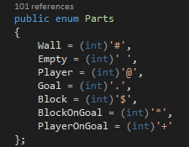
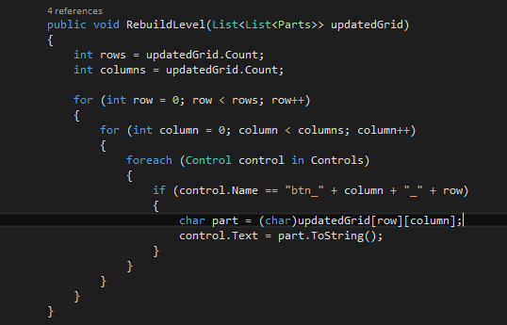
(1)Display the pieces as distinct images
The text of the buttons is replaced with a character that represents a game piece in the IFileable Interface
The game pieces are loaded into a grid. The grid is searched through by row and column. Then it loops through all the controls looking for buttons with a name of “btn_’column’_’row’”. This then grabs the char of the part at that specific location and updates the text of the button to the game piece char. This happens in the view.
WinForms View: Manual lay-out of components

Slide 7
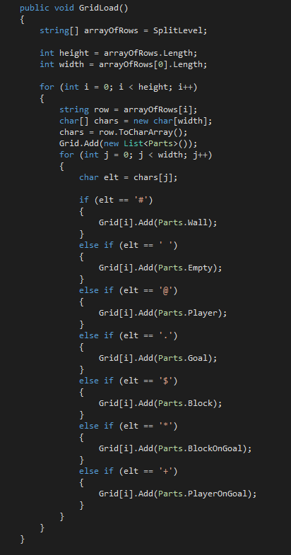
(1)Display the pieces as distinct images: Continued
Loading the grid in the game model
WinForms View: Manual lay-out of components

Slide 8
(1)Display the pieces as distinct images: Continued
Expected Mark
This feature was implemented well in this view as the different game pieces are different symbols that aren’t similar. They are also closely related to what they are trying to represent.
For example: a wall is represented by a #, and in my opinion it actually looks a bit like a wall.
These are also based off the class list that everyone had come to recognise throughout this project.
The separation between the buttons also adds to the distinctness of the images.
1/1
WinForms View: Manual lay-out of components

Slide 9
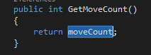
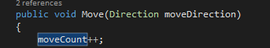
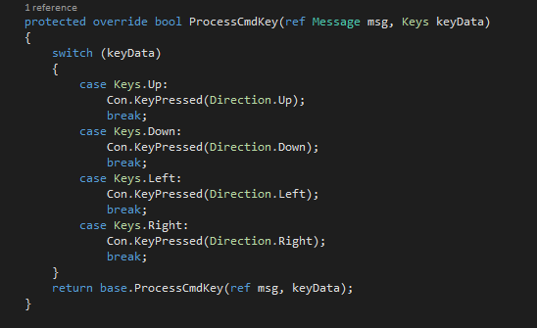
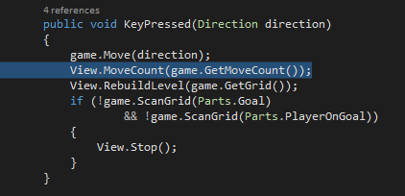
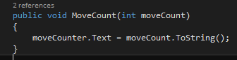
(2) Display the Move Count
Function in the game model that returns the moveCount.
The Move() function adds to the moveCount variable whenever the Move() function is called from the controller
When a direction key is pressed, the key is read in the view then passed to the controller. Then the Move() function is called and the MoveCount is updated in the view as seen bellow.
The MoveCount() is called from the controller. This function updates the text in the view.
WinForms View: Manual lay-out of components

Slide 10
(2) Display the Move Count: Continued
Expected Mark
This feature was well implemented as I was able to use the code from the model that had been previously created in the 15% assignment. It is able to count each time a key has been pressed and resets when the game is closed and then reopened. However it continues to count up whilst holding down a direction key while up against a wall. This could possibly be considered as not a move, as the key has only been pressed once so this could be amended so that it doesn’t do that. In saying that though, overall the move count feature works well.
0.9/1
WinForms View: Manual lay-out of components

Slide 11
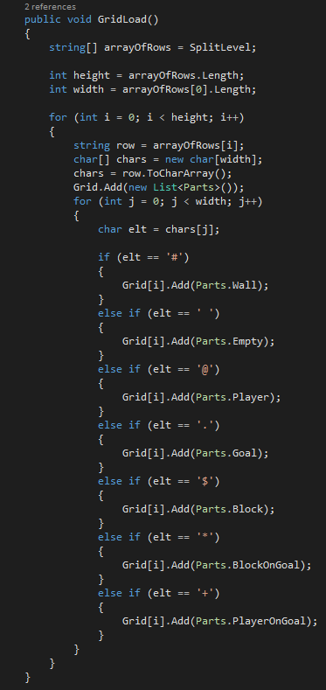
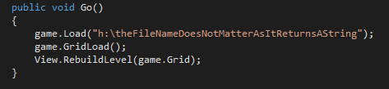
(3) Actually works – is playable - updates!
As seen in the previous video, the game works, is playable and updates.
For the grid to exist it needs to be created based from a string of chars(parts) that each represent a different player piece. The different parts are added to the grid through the GridLoad() function which is in the game model. The level is created statically in the game model as seen here.
When the Form is executed the Go() function of the controller is called. This loads the string. Loads the Grid based off the string and then builds the level to the view so that is can be visually displayed.
WinForms View: Manual lay-out of components

Slide 12
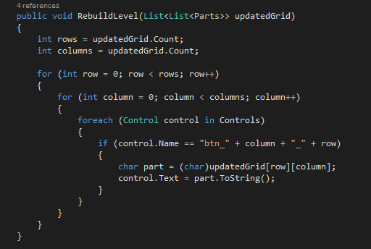
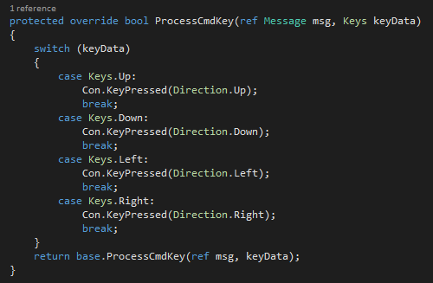
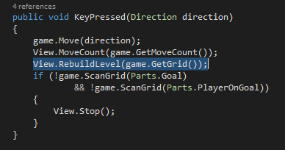
(3) Actually works – is playable - updates!
As seen in the previous video, the game works, is playable and updates.
RebuildLevel() is called initially when the form is executed. This loops through the rows and columns so that each position of the grid can be found. It then loops through all the controls(buttons) on the form to see if there are any with the name “btn_’column’_’row’”. If so it locates the part for that space and updates the text of the button so that the game can be visually seen. This function is part of the view.
This function is also called when a direction key is pressed.
When a direction key is pressed, the view sends the key direction to the controller.
The KeyPressed() function calls RebuildLevel() after the Move() function has been executed so that the new grid can be loaded and updated to the view.
WinForms View: Manual lay-out of components

Slide 13
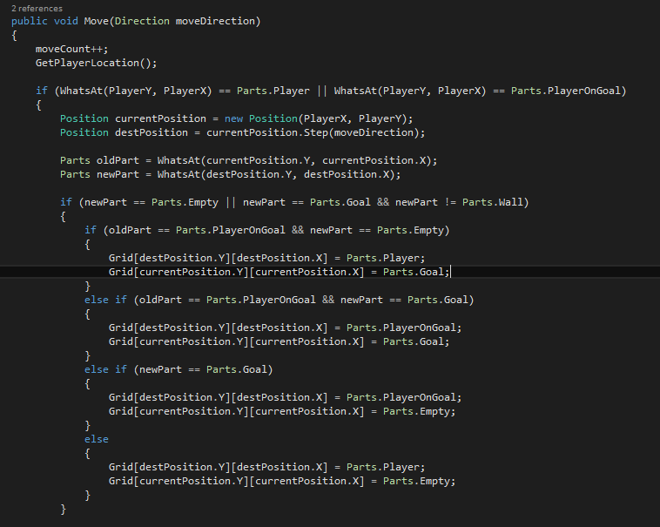
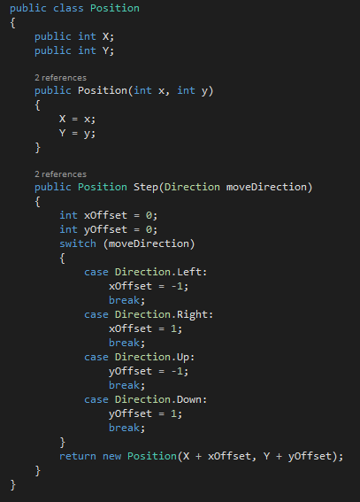
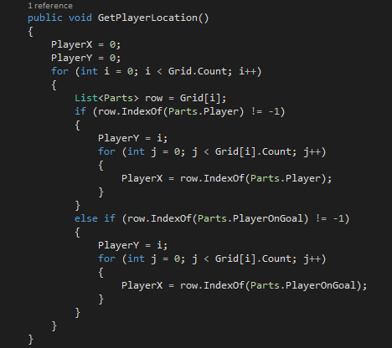
(3) Actually works – is playable - updates!: Continued
The Move() function checks the location of the player and depending on the move direction does the according Part update based on the old and new positions. The position class checks the movement direction and sets the x and y position to either positive or negative depending on the direction. For example, moving right is a positive move across the x axis. And if the position next to the player was a goal then the Part would become PlayerOnGoal.
WinForms View: Manual lay-out of components

Slide 14
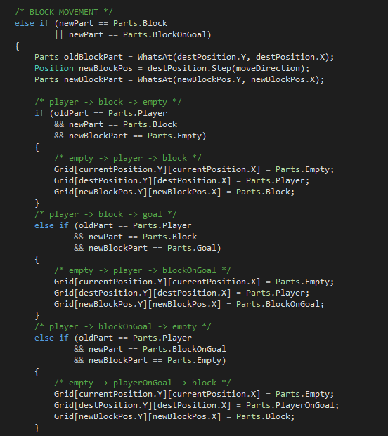
(3) Actually works – is playable - updates!: Continued
The block movement is similar to the player but requires a big if/else statement to determine what happens to the part.
For example: if a player moves right into a block, and next to the block is an empty space, then the block will move into the empty space and the player will move to where the block was.
There are more if/else statements than this
WinForms View: Manual lay-out of components

Slide 15
(3) Actually works – is playable - updates!: Continued
Expected Mark
This feature worked and allowed the Sokoban game to actually be playable, through movement and updating of the view. This was through the help of Elliot as we had worked on the game model together previously as it is a big task to do solo. It is probably possibly to tidy up the move logic so that there are less if/else statements but we were unable to do so. Other than that the game works well and performs the basic functions that a Sokoban game needs. When using the direction keys parts of the form become highlighted which can distract from the game.
0.75/1
WinForms View: Manual lay-out of components

Slide 16
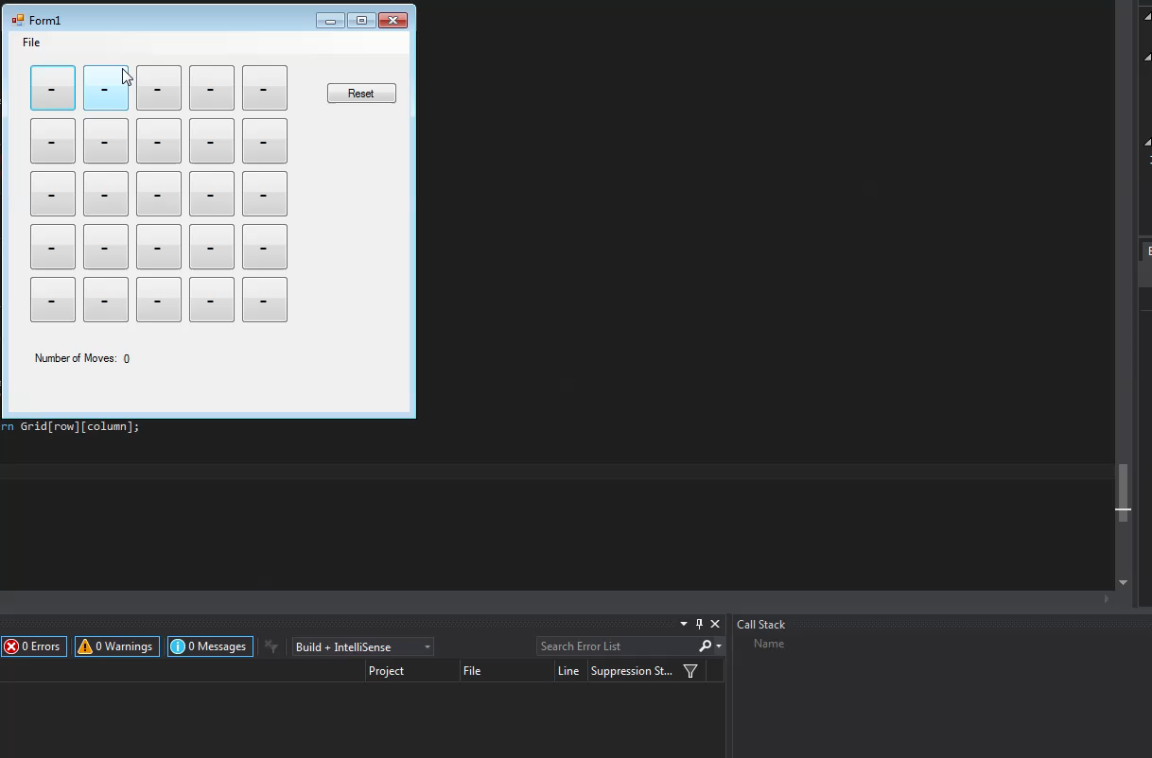
Another Must List Feature
Save and load ‘works’

Slide 17
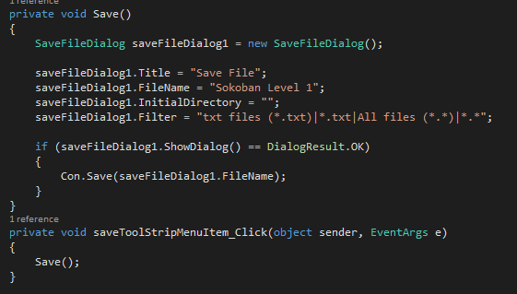
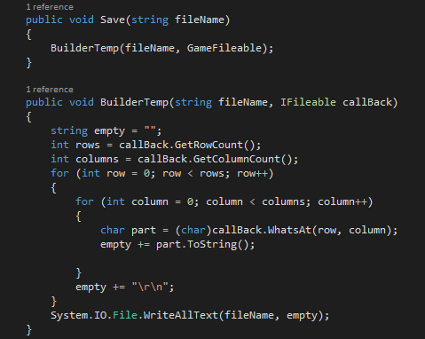
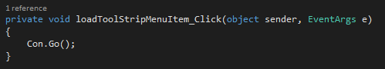
(4) Save and load
When the save button is pressed on the menustrip it opens a saveDialog in the view. The controller then uses the BuilderTemp function to break down the grid into a string that then gets written to a text file.
When pressed the load button just calls the controller Go() function which has a prebuilt level string that is then displayed on the screen.
WinForms View: Manual lay-out of components

Slide 18
(4) Save and load: Continued
Expected Mark
The save is able to get the current position of all the parts and output that to a text file. The text file could be used by a file loader to load the level to the grid. My load function doesn’t work like this, it is just used like a start button to call the controller function that loads the game from the hardcoded string. It just looks like it is being loaded from some file without the use of a dialog box. To improve this it would actually load from a text file through a dialog box.
0.65/1
WinForms View: Manual lay-out of components

Slide 19
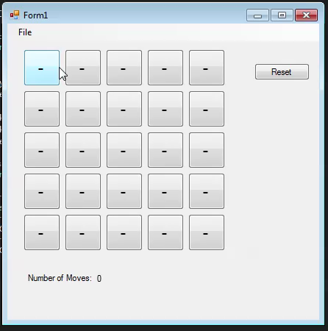
Should Feature (1) - VIDEO
Restart
WinForms View: Manual lay-out of components

Slide 20
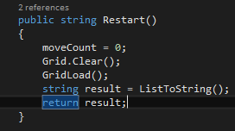
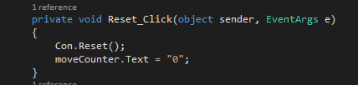
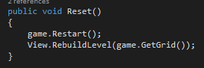
(1) Restart: Continued
In the game model, Restart() clears the grid and then reloads it from the original string that is in the controller
When reset button is clicked, the Controller is called and the moveCounter text is set back to zero
In the controller the grid is cleared and then loaded, then the view is rebuilt through the RebuildLevel() function based off the original level string
WinForms View: Manual lay-out of components

Slide 21
(1) Restart: Continued
Expected Mark
The level is able to be reset through the push of a button without any complication. I’m not sure if this method of resetting would work with a level that has been loaded from a file without storing that level in a string. I don’t think it would be too hard though to make modifications so that it did work.
1/1
WinForms View: Manual lay-out of components

Slide 22
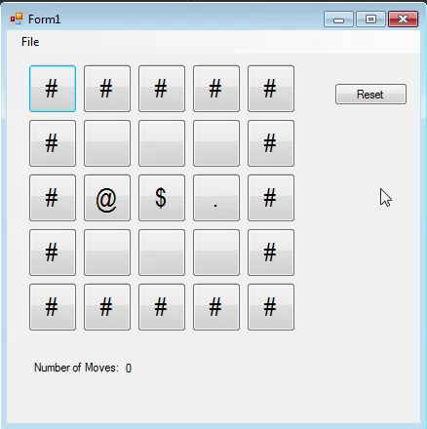
Should Feature (2) - VIDEO
Display “Win Game”
WinForms View: Manual lay-out of components

Slide 23
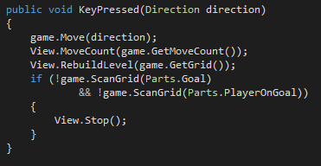
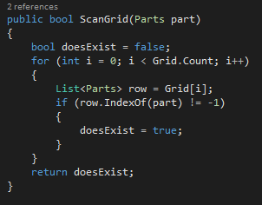
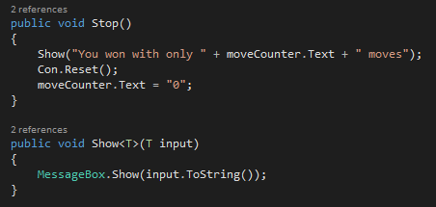
(2) Display “Win Game”: Continued
Determining if a player has won the game is based off if there are no goals or player on goals. This is found out though the use of the ScanGrid() function which checks to see if a particular part can be found.
If the statement is true then Stop() is called.
Stop() shows a message box that notifies the player that they have won. It also resets the level and the moveCounter
WinForms View: Manual lay-out of components

Slide 24
(2) Display “Win Game”: Continued
Expected Mark
The player is notified that they have completed the level with a message box. It also says how many moves they completed the level in. There is a possibility of creating a winning animation.
1/1
WinForms View: Manual lay-out of components

Slide 25
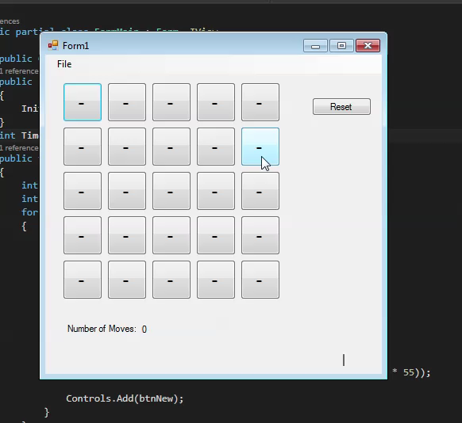
Should Feature (2) - VIDEO
Should display timer
WinForms View: System.Drawing

Slide 26
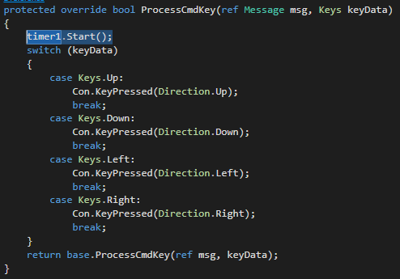
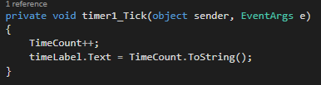
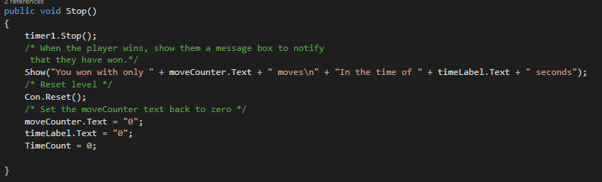
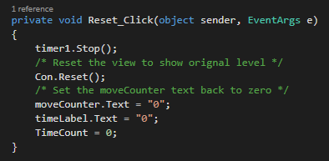
(3) Should Display Timer: Continued
Set TimeCount variable to zero
The timer starts on key press
While the timer ticks the display gets updated
If the game is won or the level is reset then the timer stops and gets reset
WinForms View: System.Drawing

Slide 27
(3) Should Display Timer : Continued
Expected Mark
The timer counts from 0 up from the time the player presses the first key. When the player wins or the level is reset so is the timer. Otherwise the timer would forever continue to count up.
1/1
WinForms View: System.Drawing

Slide 28
WinForms View
Dynamically created components

Slide 29
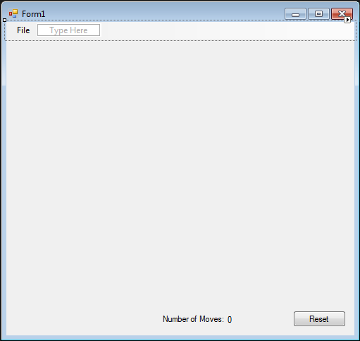
Dynamically created components
The buttons for this grid are created dynamically in the view instead of being dragged and dropped from the toolbox. This allows for easier customisation for level grid size.
WinForms View: Dynamically created components

Slide 30
Must List Features
Display the Pieces as distinct images
Display the Move Count
Actually works – is playable - updates!
Display a grid of variable size (to an upper limit) CENTRED
WinForms View: Dynamically created components

Slide 31
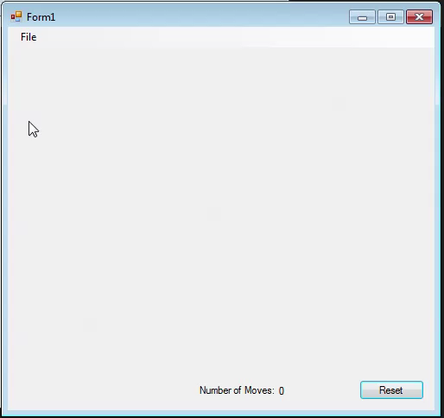
The Working Features - VIDEO
WinForms View: Dynamically created components

Slide 32
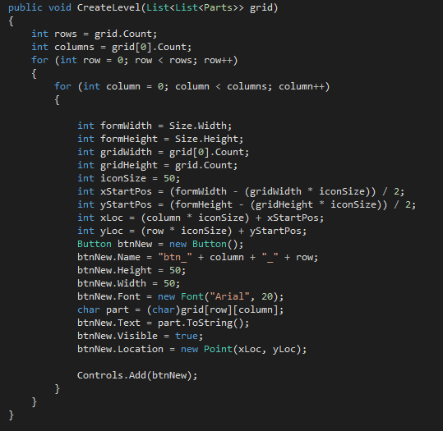
(1)Display the pieces as distinct images
The text of the buttons is replaced with a character that represents a game piece in the IFileable Interface
New buttons are created. The text of the button is added dependant on the location of the button compared to the grid. It grabs the char of the part at that specific location and updates the text of the button to the game piece char. This happens in the view.
WinForms View: Dynamically created components

Slide 33
(1)Display the pieces as distinct images: Continued
Loading the grid in the game model
WinForms View: Dynamically created components

Slide 34
(1)Display the pieces as distinct images: Continued
Expected Mark
This feature was implemented well in this view as the different game pieces are different symbols that aren’t similar. They are also closely related to what they are trying to represent.
For example: a wall is represented by a #, and in my opinion it actually looks a bit like a wall.
These are also based off the class list that everyone had come to recognise throughout this project.
The separation between the buttons also adds to the distinctness of the images.
1/1
WinForms View: Dynamically created components

Slide 35
(2) Display the Move Count
Function in the game model that returns the moveCount.
The Move() function adds to the moveCount variable whenever the Move() function is called from the controller
When a direction key is pressed, the key is read in the view then passed to the controller. Then the Move() function is called and the MoveCount is updated in the view as seen bellow.
The MoveCount() is called from the controller. This function updates the text in the view.
WinForms View: Dynamically created components

Slide 36
(2) Display the Move Count: Continued
Expected Mark
This feature was well implemented as I was able to use the code from the model that had been previously created in the 15% assignment. It is able to count each time a key has been pressed and resets when the game is closed and then reopened. However it continues to count up whilst holding down a direction key while up against a wall. This could possibly be considered as not a move, as the key has only been pressed once so this could be amended so that it doesn’t do that. In saying that though, overall the move count feature works well.
0.9/1
WinForms View: Dynamically created components

Slide 37
(3) Actually works – is playable - updates!
As seen in the previous video, the game works, is playable and updates.
For the grid to exist it needs to be created based from a string of chars(parts) that each represent a different player piece. The different parts are added to the grid through the GridLoad() function which is in the game model. The level is created statically in the game model as seen here.
When the Form is executed the Go() function of the controller is called. This loads the string. Loads the Grid based off the string and then builds the level to the view so that is can be visually displayed.
WinForms View: Dynamically created components

Slide 38
(3) Actually works – is playable - updates!
As seen in the previous video, the game works, is playable and updates.
CreateLevel() is called initially when the form is executed. This creates new buttons and names them based on their row and column. The button text is dependant on the part that is on that location of the grid. This allows the player of the game to view the parts onscreen as the name of the button is the Part symbol. This function is part of the view.
When a direction key is pressed, the view sends the key direction to the controller.
The KeyPressed() function calls RebuildLevel() after the Move() function has been executed so that the new grid can be loaded and updated to the view.
WinForms View: Dynamically created components

Slide 39
(3) Actually works – is playable - updates!: Continued
The Move() function checks the location of the player and depending on the move direction does the according Part update based on the old and new positions. The position class checks the movement direction and sets the x and y position to either positive or negative depending on the direction. For example, moving right is a positive move across the x axis. And if the position next to the player was a goal then the Part would become PlayerOnGoal.
WinForms View: Dynamically created components

Slide 40
(3) Actually works – is playable - updates!: Continued
The block movement is similar to the player but requires a big if/else statement to determine what happens to the part.
For example: if a player moves right into a block, and next to the block is an empty space, then the block will move into the empty space and the player will move to where the block was.
There are more if/else statements than this
WinForms View: Dynamically created components

Slide 41
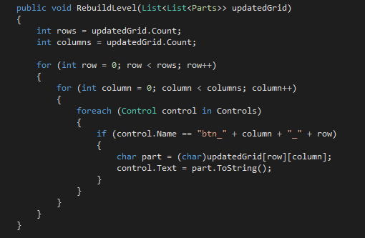
(3) Actually works – is playable - updates!: Continued
RebuildLevel() is called when a direction key has been pressed. This loops through the rows and columns so that each position of the grid can be found. It then loops through all the controls(buttons) on the form to see if there are any with the name “btn_’column’_’row’”. If so it locates the part for that space and updates the text of the button so that the game can be visually seen. This function is part of the view.
WinForms View: Dynamically created components

Slide 42
(3) Actually works – is playable - updates!: Continued
Expected Mark
This feature worked and allowed the Sokoban game to actually be playable, through movement and updating of the view. This was through the help of Elliot as we had worked on the game model together previously as it is a big task to do solo. It is probably possibly to tidy up the move logic so that there are less if/else statements but we were unable to do so. Other than that the game works well and performs the basic functions that a Sokoban game needs. When using the direction keys parts of the form become highlighted which can distract from the game.
0.75/1
WinForms View: Dynamically created components

Slide 43
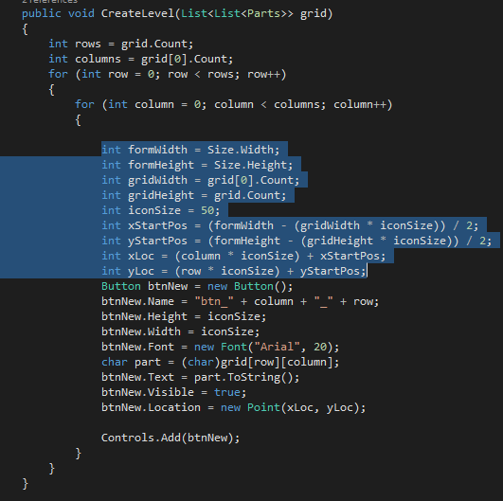
(4) Display a grid of variable size
CreateLevel() creates the grid. The size is determined by the level string. To get the grid to centre the size is determined by the width and height of the form and grid, and also the size of the button.
WinForms View: Dynamically created components

Slide 44
(4) Display a grid of variable size: Continued
Expected Mark
The grid gets centered and can be of variable size as the buttons are dynamically created. However not all the view elements are dynamically created so if a level size was to be too big it would overlap these elements.
0.9/1
WinForms View: Dynamically created components

Slide 45
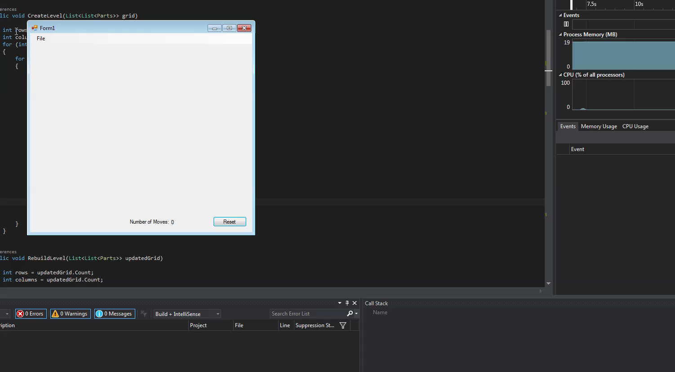
Another Must List Feature (5)
Save and load ‘works’
WinForms View: Dynamically created components

Slide 46
(5) Save and load
When the save button is pressed on the menustrip it opens a saveDialog in the view. The controller then uses the BuilderTemp function to break down the grid into a string that then gets written to a text file.
When pressed the load button just calls the controller Go() function which has a prebuilt level string that is then displayed on the screen.
WinForms View: Manual lay-out of components

Slide 47
(5) Save and load: Continued
Expected Mark
The save is able to get the current position of all the parts and output that to a text file. The text file could be used by a file loader to load the level to the grid. My load function doesn’t work like this, it is just used like a start button to call the controller function that loads the game from the hardcoded string. It just looks like it is being loaded from some file without the use of a dialog box. To improve this it would actually load from a text file through a dialog box.
0.65/1
WinForms View: Manual lay-out of components

Slide 48
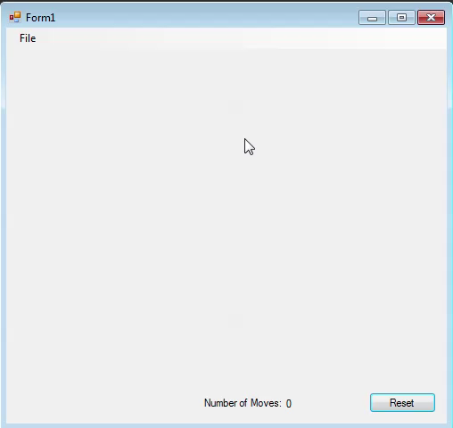
Should Feature (1) - VIDEO
Restart
WinForms View: Manual lay-out of components

Slide 49
(1) Restart: Continued
In the game model, Restart() clears the grid and then reloads it from the original string that is in the controller
When reset button is clicked, the Controller is called and the moveCounter text is set back to zero
In the controller the grid is cleared and then loaded, then the view is rebuilt through the RebuildLevel() function based off the original level string
WinForms View: Manual lay-out of components

Slide 50
(1) Restart: Continued
Expected Mark
The level is able to be reset through the push of a button without any complication. I’m not sure if this method of resetting would work with a level that has been loaded from a file without storing that level in a string. I don’t think it would be too hard though to make modifications so that it did work.
1/1
WinForms View: Manual lay-out of components

Slide 51
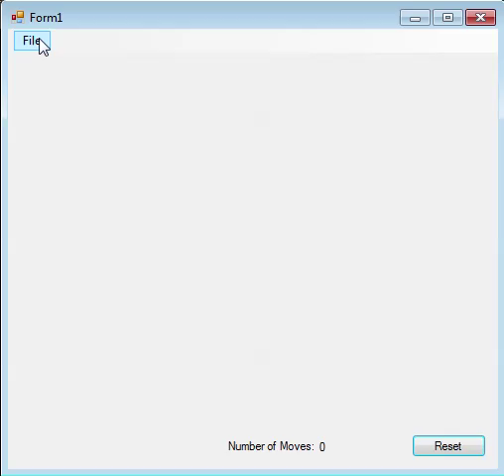
Should Feature (2) - VIDEO
Display “Win Game”
WinForms View: Manual lay-out of components

Slide 52
(2) Display “Win Game”: Continued
Determining if a player has won the game is based off if there are no goals or player on goals. This is found out though the use of the ScanGrid() function which checks to see if a particular part can be found.
If the statement is true then Stop() is called.
Stop() shows a message box that notifies the player that they have won. It also resets the level and the moveCounter
WinForms View: Manual lay-out of components

Slide 53
(2) Display “Win Game”: Continued
Expected Mark
The player is notified that they have completed the level with a message box. It also says how many moves they completed the level in. There is a possibility of creating a winning animation.
1/1
WinForms View: Manual lay-out of components

Slide 54
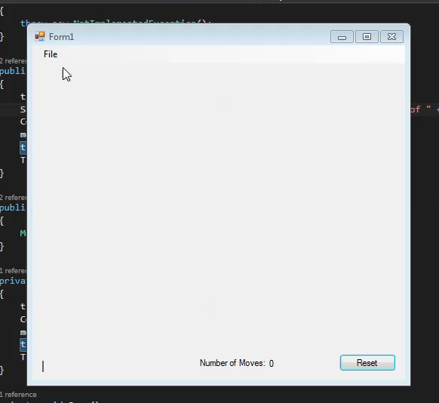
Should Feature (2) - VIDEO
Should display timer
WinForms View: System.Drawing

Slide 55
(3) Should Display Timer: Continued
Set TimeCount variable to zero
The timer starts on key press
While the timer ticks the display gets updated
If the game is won or the level is reset then the timer stops and gets reset
WinForms View: System.Drawing

Slide 56
(3) Should Display Timer : Continued
Expected Mark
The timer counts from 0 up from the time the player presses the first key. When the player wins or the level is reset so is the timer. Otherwise the timer would forever continue to count up.
1/1
WinForms View: System.Drawing

Slide 57
WinForms View
System.Drawing

Slide 58
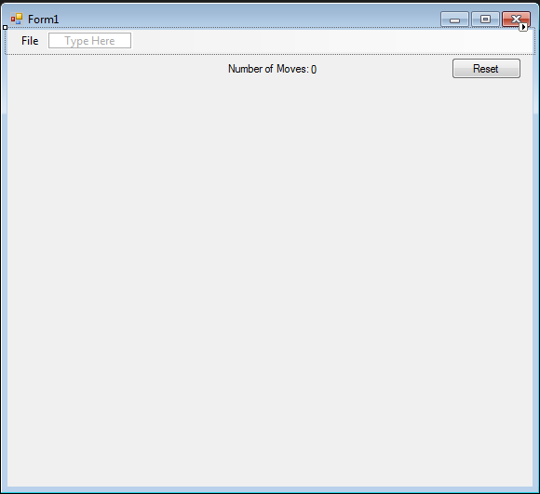
System.Drawing
This form using System.Drawing to dynamically draw sprites to the grid to display different parts. This adds a fun factor to Sokoban and creates a more appealing view.
WinForms View: System.Drawing

Slide 59
Must List Features
Display the Pieces as distinct images
Display the Move Count
Actually works – is playable - updates!
Display a grid of variable size (to an upper limit) CENTRED
WinForms View: System.Drawing

Slide 60
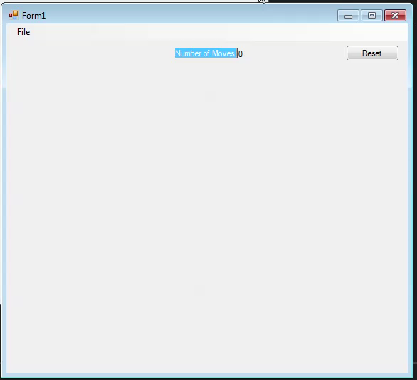
The Working Features - VIDEO
WinForms View: System.Drawing

Slide 61
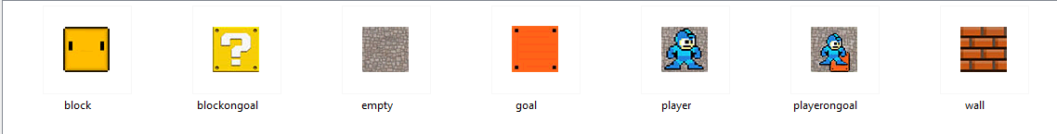
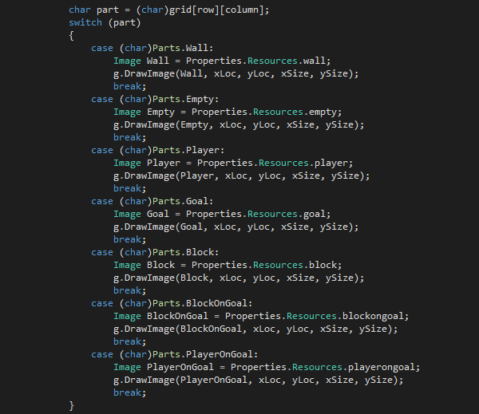
(1)Display the pieces as distinct images
Each Part is associated with a different jpeg so that each image is distinct.
System.Drawing is able to create the game pieces as images instead of text on a button. To do this I used a switch statement that checked the grid to find which part was at that certain location. This then grabs the image associated and adds that to the view.
This happens in the view.
WinForms View: System.Drawing

Slide 62
(1)Display the pieces as distinct images: Continued
Loading the grid in the game model
WinForms View: System.Drawing

Slide 63
(1)Display the pieces as distinct images: Continued
Expected Mark
This feature was implemented well in this view as the different game pieces are distinct images that look like the part that they are supposed to be.
For example: a wall is represented by a image of a brick wall.
1/1
WinForms View: System.Drawing

Slide 64
(2) Display the Move Count
Function in the game model that returns the moveCount.
The Move() function adds to the moveCount variable whenever the Move() function is called from the controller
When a direction key is pressed, the key is read in the view then passed to the controller. Then the Move() function is called and the MoveCount is updated in the view as seen bellow.
The MoveCount() is called from the controller. This function updates the text in the view.
WinForms View: System.Drawing

Slide 65
(2) Display the Move Count: Continued
Expected Mark
This feature was well implemented as I was able to use the code from the model that had been previously created in the 15% assignment. It is able to count each time a key has been pressed and resets when the game is closed and then reopened. However it continues to count up whilst holding down a direction key while up against a wall. This could possibly be considered as not a move, as the key has only been pressed once so this could be amended so that it doesn’t do that. In saying that though, overall the move count feature works well.
0.9/1
WinForms View: System.Drawing

Slide 66
(3) Actually works – is playable - updates!
As seen in the previous video, the game works, is playable and updates.
For the grid to exist it needs to be created based from a string of chars(parts) that each represent a different player piece. The different parts are added to the grid through the GridLoad() function which is in the game model. The level is created statically in the game model as seen here.
When the Form is executed the Go() function of the controller is called. This loads the string. Loads the Grid based off the string and then builds the level to the view so that is can be visually displayed.
WinForms View: System.Drawing

Slide 67
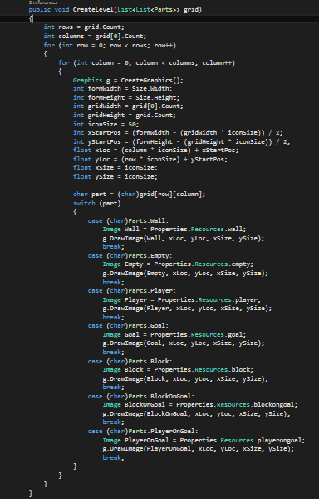
(3) Actually works – is playable - updates!
As seen in the previous video, the game works, is playable and updates.
CreateLevel() is called initially when the form is executed. This uses a switch statement that looks at the parts on the grid and draws an image for that part through the use of a switch statement.
This function is part of the view.
WinForms View: System.Drawing

Slide 68

(3) Actually works – is playable - updates!
When a direction key is pressed, the view sends the key direction to the controller.
The KeyPressed() function calls CreateLevel() after the Move() function has been executed so that the new view can be redrawn from the updated grid.
WinForms View: System.Drawing

Slide 69
(3) Actually works – is playable - updates!: Continued
The Move() function checks the location of the player and depending on the move direction does the according Part update based on the old and new positions. The position class checks the movement direction and sets the x and y position to either positive or negative depending on the direction. For example, moving right is a positive move across the x axis. And if the position next to the player was a goal then the Part would become PlayerOnGoal.
WinForms View: System.Drawing

Slide 70
(3) Actually works – is playable - updates!: Continued
The block movement is similar to the player but requires a big if/else statement to determine what happens to the part.
For example: if a player moves right into a block, and next to the block is an empty space, then the block will move into the empty space and the player will move to where the block was.
There are more if/else statements than this
WinForms View: System.Drawing

Slide 71

(3) Actually works – is playable - updates!: Continued
RebuildLevel() is usually called when a direction key has been pressed. However for this view, it is redundant as it is easier to just redraw the level after each direction key has been pressed. Therefore, CreateLevel() is recalled after a movement instead of RebuildLevel().
WinForms View: System.Drawing

Slide 72
(3) Actually works – is playable - updates!: Continued
Expected Mark
This feature worked and allowed the Sokoban game to actually be playable, through movement and updating of the view. This was through the help of Elliot as we had worked on the game model together previously as it is a big task to do solo. It is probably possibly to tidy up the move logic so that there are less if/else statements but we were unable to do so. Other than that the game works well and performs the basic functions that a Sokoban game needs. When using the direction keys parts of the form become highlighted which can distract from the game. The ‘win dialog’ does rub out the System.Drawing which ruins the look of the game when a level has been completed.
0.70/1
WinForms View: System.Drawing

Slide 73

(4) Display a grid of variable size
CreateLevel() creates the grid. The size is determined by the level string. To get the grid to centre the size is determined by the width and height of the form and grid, and also the size of the button.
WinForms View: System.Drawing

Slide 74
(4) Display a grid of variable size: Continued
Expected Mark
The grid gets centered and can be of variable size as the buttons are dynamically created. However not all the view elements are dynamically created so if a level size was to be too big it would overlap these elements.
0.9/1
WinForms View: System.Drawing

Slide 75

Another Must List Feature (5)
Save and load ‘works’
WinForms View: System.Drawing

Slide 76
(5) Save and load
When the save button is pressed on the menustrip it opens a saveDialog in the view. The controller then uses the BuilderTemp function to break down the grid into a string that then gets written to a text file.
When pressed the load button just calls the controller Go() function which has a prebuilt level string that is then displayed on the screen.
WinForms View: System.Drawing

Slide 77
(5) Save and load: Continued
Expected Mark
The save is able to get the current position of all the parts and output that to a text file. The text file could be used by a file loader to load the level to the grid. My load function doesn’t work like this, it is just used like a start button to call the controller function that loads the game from the hardcoded string. It just looks like it is being loaded from some file without the use of a dialog box. To improve this it would actually load from a text file through a dialog box.
0.65/1
WinForms View: System.Drawing

Slide 78

Should Feature (1) - VIDEO
Restart
WinForms View: System.Drawing

Slide 79
(1) Restart: Continued
In the game model, Restart() clears the grid and then reloads it from the original string that is in the controller
When reset button is clicked, the Controller is called and the moveCounter text is set back to zero
In the controller the grid is cleared and then loaded, then the view is rebuilt through the RebuildLevel() function based off the original level string
WinForms View: System.Drawing

Slide 80
(1) Restart: Continued
Expected Mark
The level is able to be reset through the push of a button without any complication. I’m not sure if this method of resetting would work with a level that has been loaded from a file without storing that level in a string. I don’t think it would be too hard though to make modifications so that it did work.
1/1
WinForms View: System.Drawing

Slide 81

Should Feature (2) - VIDEO
Display “Win Game”
WinForms View: System.Drawing

Slide 82
(2) Display “Win Game”: Continued
Determining if a player has won the game is based off if there are no goals or player on goals. This is found out though the use of the ScanGrid() function which checks to see if a particular part can be found.
If the statement is true then Stop() is called.
Stop() shows a message box that notifies the player that they have won. It also resets the level and the moveCounter
WinForms View: System.Drawing

Slide 83
(2) Display “Win Game”: Continued
Expected Mark
The player is notified that they have completed the level with a message box. It also says how many moves they completed the level in. There is a possibility of creating a winning animation.
1/1
WinForms View: System.Drawing

Slide 84

Should Feature (2) - VIDEO
Should display timer
WinForms View: System.Drawing

Slide 85
(3) Should Display Timer: Continued
Set TimeCount variable to zero
The timer starts on key press
While the timer ticks the display gets updated
If the game is won or the level is reset then the timer stops and gets reset
WinForms View: System.Drawing

Slide 86
(3) Should Display Timer : Continued
Expected Mark
The timer counts from 0 up from the time the player presses the first key. When the player wins or the level is reset so is the timer. Otherwise the timer would forever continue to count up.
1/1
WinForms View: System.Drawing

Slide 87
My View other model
Use your View with another student’s controller and model

Slide 88

What Happened?
After a good amount of time trying to implement my view with Elliot’s model and controller, I found it wasn’t an easy implementation due to the different interfaces between Elliot and myself.
Elliot’s Controller

Slide 89

What Happened?: Continued
My Controller

Slide 90
What Happened?: Continued
Because Elliot had also implemented Filer and Level Designer he had a lot more interfaces and non-static code. This meant that for me to be able to use my view with his model and controller I’d have to completely rewrite it to fit with his implementation. We had gone separate paths when writing our code which makes it a lot more difficult to get the files to work together.

Slide 91
Conclusion
If Elliot and I had planned from the start to mix our files then we possibly could have worked out the best possible interfaces that we could both use to make cross implementation work more smoothly later on.

Slide 92
Expected Mark
Even though this did not work at all I did learn about how different interfaces are very difficult to link together. This highlights the importance of an interface when it comes to wanting to be able to use reusable code.
5/8

Slide 93
Other View My model
Use your controller and model with another student’s View

Slide 94

What Happened?
I got Josh’s view to work with my model and controller, the commented code is what I had to change to make it work with my model and controller.

Slide 95
Expected Mark
This was a lot easier than the implementation troubles that I had when trying to link the MVC with Elliot’s files. I managed to get the view running and displaying the level but the movement doesn’t work.
5/8

Slide 96
Theory 1
Code programs in the specified language using the prescribed standards

Slide 97
Statement of Theory
Coding conventions demonstrate best practice and enable readers to understand code more quickly by making assumptions based on previous experience.
Theory 1

Slide 98
Credible Reference
https://msdn.microsoft.com/en-us/library/ff926074.aspx
Theory 1

Slide 99


What I Have Done
Layout Conventions - View
I used layout convention as I found this the most readable way for me to be able to understand the code that I was writing.
ex2
ex1
Theory 1

Slide 100
What I Have Done: Continued
Layout Conventions - View
Good layout uses formatting to emphasize the structure of your code and to make the code easier to read.
Write only one statement per line.
Write only one declaration per line.
If continuation lines are not indented automatically, indent them one tab stop (four spaces).
Add at least one blank line between method definitions and property definitions.
Use parentheses to make clauses in an expression apparent, as shown in the following code.
Theory 1

Slide 101


What I Have Done: Continued
Language Guidelines - View
&& and || Operators: example
To avoid exceptions and increase performance by skipping unnecessary comparisons, use && instead of & and || instead of | when you perform comparisons, as shown in the following example
String Data Type: example
Use the + operator to concatenate short strings, as shown in the following code.
Theory 1

Slide 102

What I Have Done: Continued
Commenting Conventions - View
Comments are the best way to keep track of what each section of code is doing.
Place the comment on a separate line, not at the end of a line of code.
Begin comment text with an uppercase letter.
End comment text with a period.
Insert one space between the comment delimiter (//) and the comment text.
Theory 1

Slide 103
Comparison, Evaluation, Statement
Layout Conventions
VS
Comparison
This is the same code but written without any layout conventions. It is not as reader friendly.
Theory 1

Slide 104
Comparison, Evaluation, Statement: Continued
Layout Conventions
Evaluation
The most effective approach is to use the layout conventions as they are reader friendly and the most recognised way to structure code.
Statement
I believe that I followed the Layout conventions effectively to be the most readable that it could be.
Theory 1

Slide 105

Comparison, Evaluation, Statement
Language Guidelines - && and || Operators
VS
Comparison
Both these options work perfectly fine but the && increases performance by skipping unnecessary comparisons (such as an if inside an if)
Theory 1

Slide 106
Comparison, Evaluation, Statement: Conclusion
Language Guidelines - && and || Operators
Evaluation
In this case the most effective approach was to use the && instead of a nested if, as it increases performance by skipping unnecessary comparisons.
Statement
I believe that I followed the language guideline effectively to create performance enhanced code.
Theory 1

Slide 107

Comparison, Evaluation, Statement
Commenting Conventions
VS
Comparison
There are two different ways to comment code. Block comment and line comment. They are used situationally.
Theory 1

Slide 108
Comparison, Evaluation, Statement: Continued
Commenting Conventions
Evaluation
I believe I used the most effective coding approach to comment single lines of code with the ‘//’.
Statement
I could have possibly put the first comment in a block comment (‘/* */’) as it was more than a single line comment.
Theory 1

Slide 109
Theory 2
Produce and execute testing strategies at the systems level using a unit testing framework

Slide 110
Statement of Theory
Writing unit tests before you write the code is recommended as it makes you think through exactly what you want to do. A unit test is a method that invokes methods in the system under test and verifies the results. A unit test is usually written by a developer, who ideally writes the test either shortly before or not long after the code under test is written.
Theory 2

Slide 111
Credible Reference
https://msdn.microsoft.com/en-us/library/jj159340.aspx
Unit tests in Visual Studio
Test-first development
Theory 2

Slide 112


What I Have Done
Unit testing was the quickest way to test the model without creating the view.
I used unit tests to test things like player movement and grid creation
I wrote my test units using the arrange, act, assert method.
Theory 2

Slide 113
Comparison, Evaluation, Statement
Comparison
Another approach would be to create the view for the model and then use debugging and lots of different values until you got something to work. This is a slow approach and definitely not as good as unit testing.
VS
Theory 2

Slide 114
Comparison, Evaluation, Statement: Continued
Evaluation
Unit testing is a fast and efficient way to test sections of code to be sure that it does as intended. It is important to not be tempted to make one test method exercise more than one aspect of the unit's behavior. Doing so leads to tests that are difficult to read and update. It can also lead to confusion when you are interpreting a failure.
Statement
It would have been good to test a more wide range of possibilities to get a more extensive idea on the possibilities of the model. It would also have benefited me if I had forethought the model before starting and then being unsure on what to unit test.
Theory 2

Slide 115
Theory 3
Describe and use common Design Patterns, Algorithms and programming language Idioms.

Slide 116
Statement of Theory
The Model-View-Controller (MVC) pattern separates the modeling of the domain, the presentation, and the actions based on user input into three separate classes [Burbeck92]:
Model. The model manages the behavior and data of the application domain, responds to requests for information about its state (usually from the view), and responds to instructions to change state (usually from the controller).
View. The view manages the display of information.
Controller. The controller interprets the mouse and keyboard inputs from the user, informing the model and/or the view to change as appropriate.
Theory 3

Slide 117
Credible Reference
https://msdn.microsoft.com/en-us/library/ff649643.aspx
Solution
Theory 3

Slide 118



What I Have Done
Model
View
Controller – has reference to the model and view
I have a model which managers the data, a view that displays the information and a controller that interprets the input. This helps with readability.
Theory 3

Slide 119
Comparison, Evaluation, Statement
Comparison
An alternative to MVC is to not use separate files. This would mean having all the data, input interpretation and the display in one file. This would not make the code very reusable.
Evaluation
MVC is an effective way to separate the display, code and inputs and makes the code more reusable.
Statement
My model needs to be more SOLID so that it can be reused for other Sokoban game implementations.
Theory 3

